Slide 1
Lab 3: Variability Due to the Measuring Instrument
As you enter room:
* Find your name on the sign in sheet.
Sign In by your Name
Find the Table you were randomly assigned.
** Sit at any of the seats and the table you were assigned.
Graded Lab 2 Reports will be returned – keep these in case of an issue with the gradebook

Slide 2
Materials Needed for This Lab
Each table should have the following:
A container of beads.
A Measuring Cup that measures 1 cup.
A Measuring Cup that measures 1/3 cup.
A plastic container to weigh the beads in.
A scale.

Slide 3
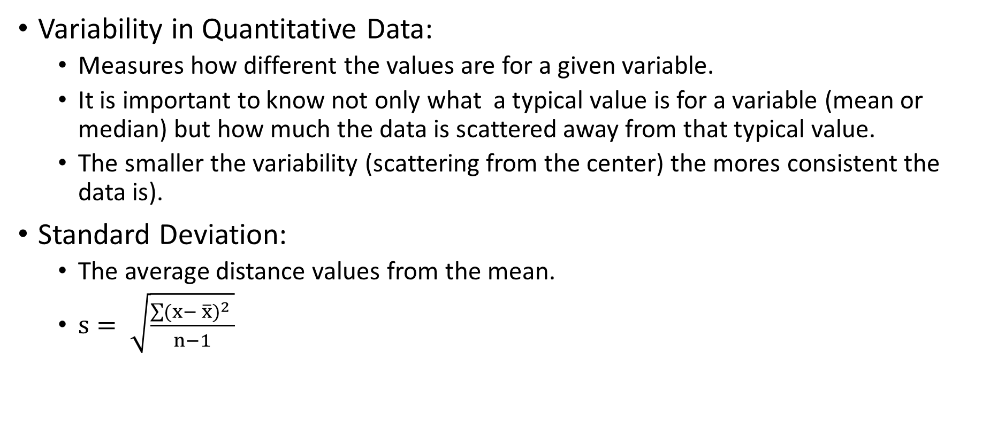
Concepts Needed for Lab 3
Variability in Quantitative Data:
Measures how different the values are for a given variable.
It is important to know not only what a typical value is for a variable (mean or median) but how much the data is scattered away from that typical value.
The smaller the variability (scattering from the center) the mores consistent the data is).
Standard Deviation:
The average distance values from the mean.
$s= \sqrt{\frac{\sum{{(x− \overline{x})}^{2} }}{n−1}}$

Slide 4
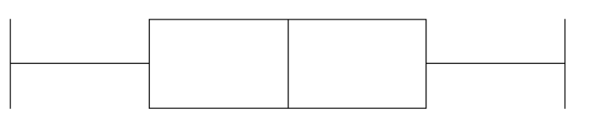
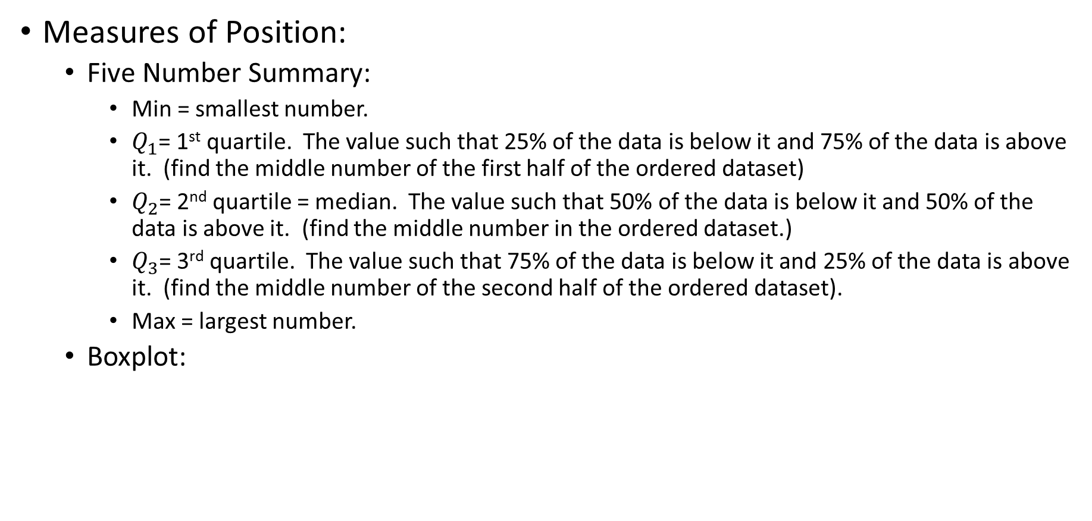



Concepts Needed for Lab 3
Measures of Position:
Five Number Summary:
Min = smallest number.
$Q_{1}$= 1st quartile. The value such that 25% of the data is below it and 75% of the data is above it. (find the middle number of the first half of the ordered dataset)
$Q_{2}$= 2nd quartile = median. The value such that 50% of the data is below it and 50% of the data is above it. (find the middle number in the ordered dataset.)
$Q_{3}$= 3rd quartile. The value such that 75% of the data is below it and 25% of the data is above it. (find the middle number of the second half of the ordered dataset).
Max = largest number.
Boxplot:
Min
$Q_{1}$
$Q_{2}$
$Q_{3}$
Max

Slide 5
Data Collection for Lab 3
Each lab table will collect their own set of data.
10 measurements will be taken with both measuring tools:
10 measurements will be taken with the 1 cup measuring cup.
10 measurements will be taken with 3 – 1/3 cup measuring cups.

Slide 6
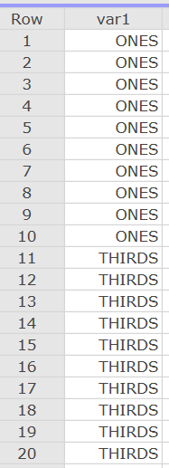
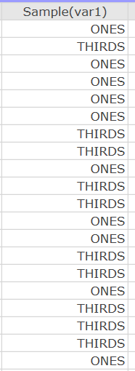
Data Collection for Lab 3
Step 1: Randomize the order of the measurement tool:
We don’t want to do all 10 measurements with the 1 cup measuring cup and then all 10 measurements with the 1/3 measuring cup.
Think about why we want to randomize the order – this is question #6.
In StatCrunch:
Type “ONES” 10 times in the first column and then type “THIRDS” 10 times in the first column.
Click Data -> Sample:
select columns: var1.
Sample size 20.
Click Computer.
Fill in the variable column in Table 3.3 on page 20 (you may skip Table 3.2 on page 19) with the output from StatCrunch.

Slide 7
Data Collection for Lab 3
Step 2: Following the order in column Variable in Table 3.3 on page 20 take the measurements.
Place the empty plastic container on the scale and zero the scale.
Take the appropriate measuring tool (either 1 cup or 1/3 cup measuring cups) and scope out beads to fill the measuring tool. Then pour the beads into the plastic container on the scale.
Record the weight (in grams) for 1 cup measurements in table 3.3 on page 20.
Make sure you scoop 3 1/3 cups when you are doing the THIRDS.

Slide 8
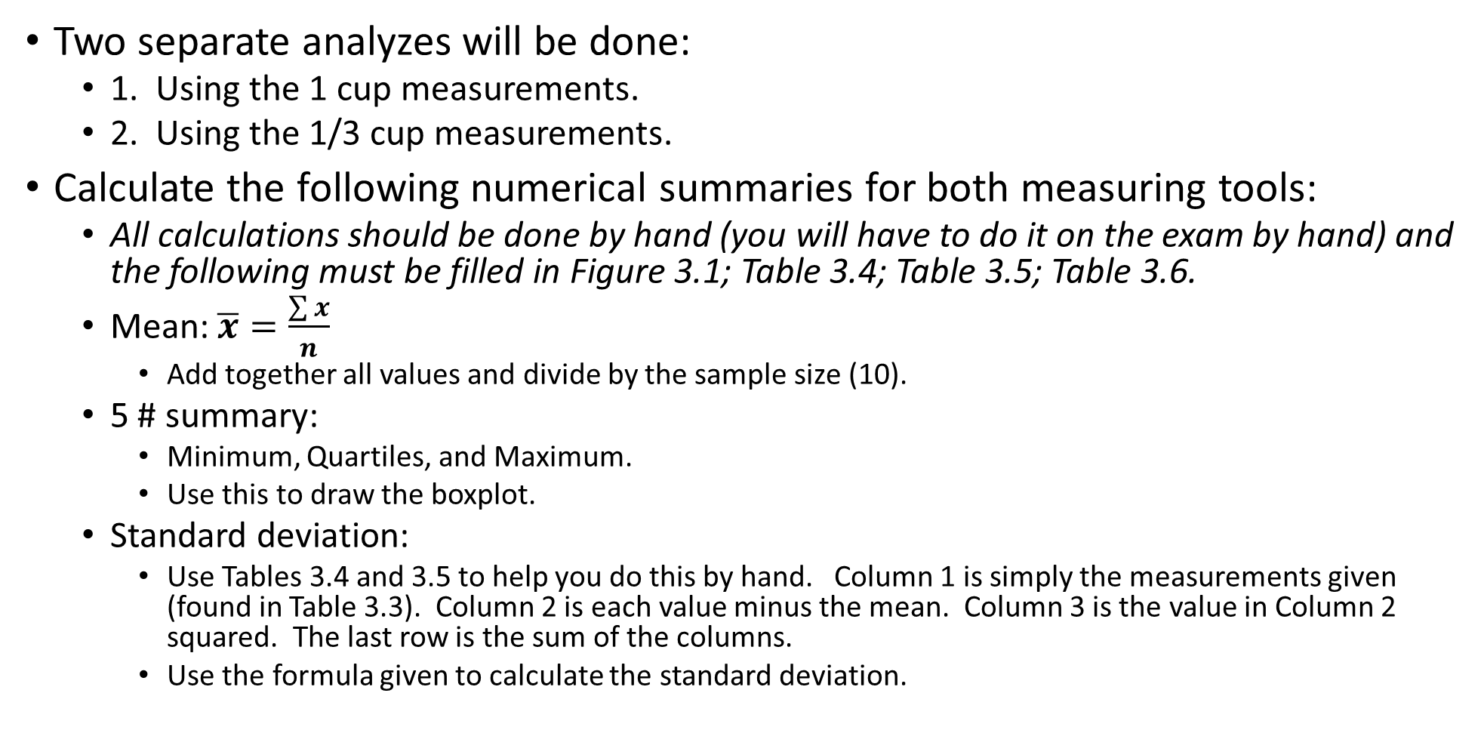
Data Analysis for Lab 3
Two separate analyzes will be done:
1. Using the 1 cup measurements.
2. Using the 1/3 cup measurements.
Calculate the following numerical summaries for both measuring tools:
All calculations should be done by hand (you will have to do it on the exam by hand) and the following must be filled in Figure 3.1; Table 3.4; Table 3.5; Table 3.6.
Mean: $\overline{x}=\frac{\sum{x}}{n}$
Add together all values and divide by the sample size (10).
5 # summary:
Minimum, Quartiles, and Maximum.
Use this to draw the boxplot.
Standard deviation:
Use Tables 3.4 and 3.5 to help you do this by hand. Column 1 is simply the measurements given (found in Table 3.3). Column 2 is each value minus the mean. Column 3 is the value in Column 2 squared. The last row is the sum of the columns.
Use the formula given to calculate the standard deviation.

Slide 9
Before you Leave
Turn in pages 19-23 from the lab book (you can leave page 19 blank) Everyone needs to turn in their own work.
Make sure all tables and figures are filled in on pages 20 – 21.
Make sure you answer all questions completely.
If it says explain then you need to justify your answer using something from the analysis.
Reality Check question is in reference to the Reality Check box on page 17.

